Slide 1
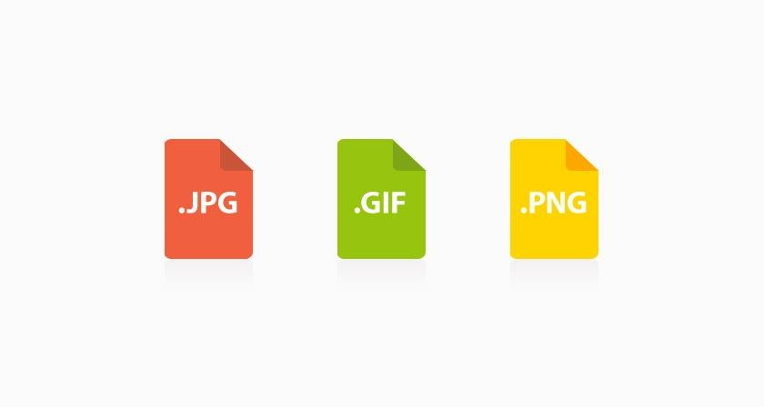
Different image file formats
What is the image-based formats?
Image Format describes how data related to the image will be stored.
Data can be stored in compressed, Uncompressed or vector format.

Slide 2
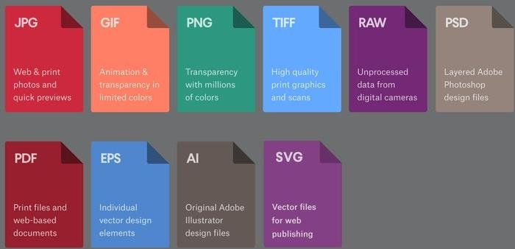
File format extensions for image files
.ai - Adobe Illustrator file
.bmp - Bitmap image
.gif - GIF image
.ico - Icon file
.jpeg or .jpg - JPEG image

Slide 3
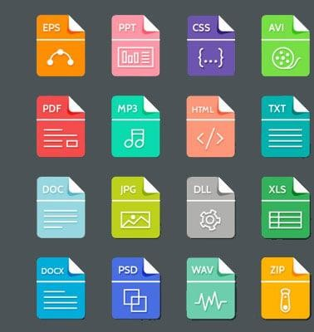
File format extensions for image files
.png - PNG image
.ps - PostScript file
.psd - PSD image
.svg - Scalable Vector Graphics file
.tif or .tiff - TIFF image

Slide 4
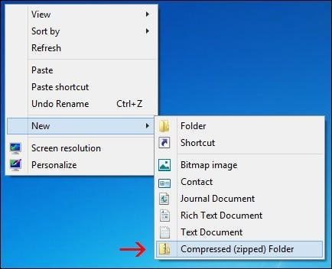
Advantages of compressing
files
What Is a Compressed File?
A compressed file is any file containing one or more files or directory that is smaller than their original file size.

Slide 5
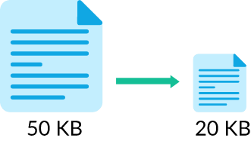
Why Compress Files?
A compressed file takes up less storage space
Several files and folders are combined into one package that is easy to manage

Slide 6
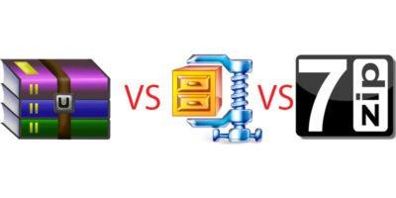
Common Compression and
Extraction Methods
zip
rar
gz
7z

Slide 7
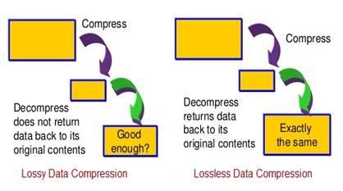
Advantages & Disadvantages of
Using File Compression
Advantages
Increased computing efficiency
Quicker transfers
Improved file integrity
Email/webpage accessibility

Slide 8
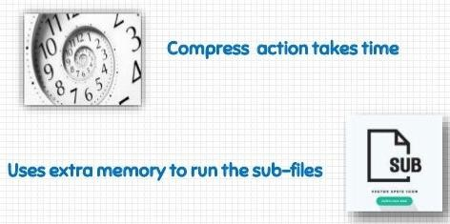
Disadvantages
Memory Issue
Speed
File Size
Viruses and Malware
File Transfer

Slide 9
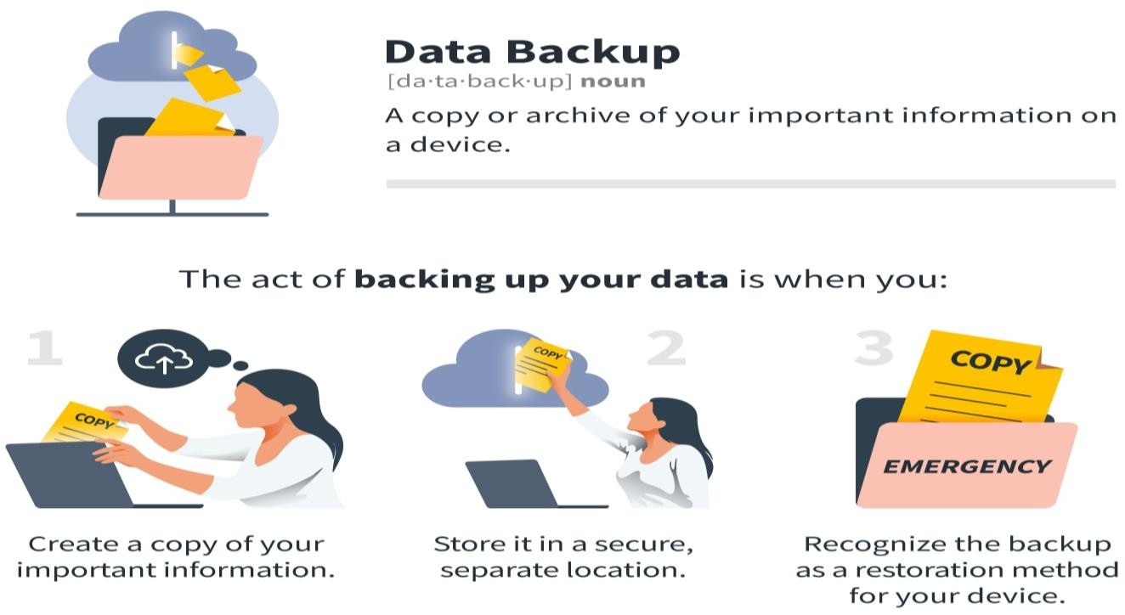
Distinguish between backup
and cloning
What is Backup?
Backup is the process of creating a copy of the data on your system that you use for recovery in case your original data is lost or corrupted.
You can also use backup to recover
copies of older files if you have deleted
them from your system.

Slide 10
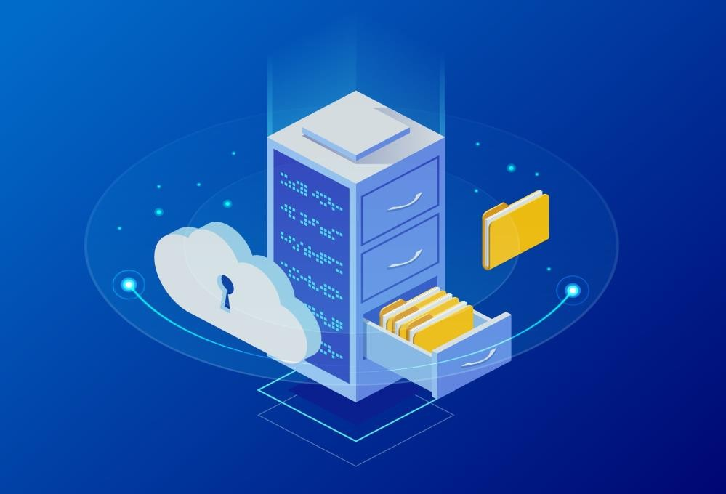
Why should I back up my data?
Data loss prevention
Natural disaster
Hard drive Fails
Lost devices
Tax reporting and audits
Cyberthreats

Slide 11
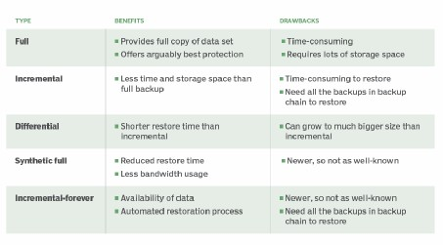
Advantages and disadvantages of backup
Advantages
Quick Access to Files
Protection Against Power Failures
Added Anti-Virus Protection
Safeguard Against Failed Hard Drive
Recovery if Operating System Fails

Slide 12

Disadvantages
Hardware failure
Hidden costs
Failed recoveries

Slide 13

What is Cloning?
Cloning is also used to describe the act of making the exact copy of a directory file or disk inclusive of any subdirectories or files within the disk or directory.

Slide 14
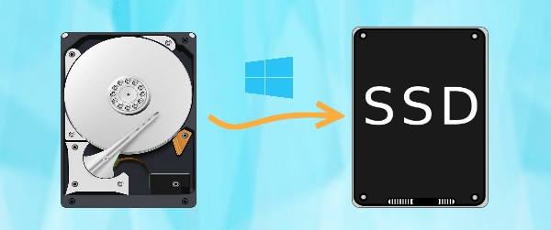
Advantages and disadvantages of
Cloning
Advantages
A faulty computer can be wiped clean of data and restored from the untouched master image
Don't have to waste the installing individual applications to new computers.
A comprehensive backup of operating
systems and installed softwares

Slide 15
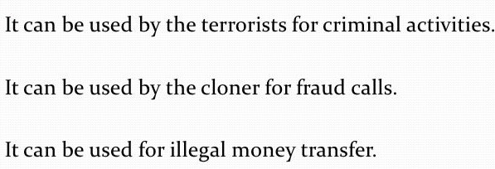
Disadvantages
Need to have a high number of the same hardware for the same image
Must have dedicated IT staff when dealing with more than just a few computers

Slide 16
Thank You

